Slide 1

Chapter 2
Understanding the Environments of Business
Copyright © 2014 Pearson Canada Inc.
2-<number>

Slide 2
Learning Objectives
1. Explain the concepts of organizational boundaries and multiple organizational environments.
2. Explain the importance of the economic environment to business and identify the factors used to evaluate the performance of an economic system.
Describe the technological environment and its role in business.
4. Describe the political-legal environment and its role in business.
Copyright © 2014 Pearson Canada Inc.
2-<number>
Notes:
These learning objectives are based upon those at the beginning of the chapter. For a review of learning objectives, see the summary at the end of the chapter, as well as the list of key terms.

Slide 3
Learning Objectives
5. Describe the socio-cultural environment and its role in business.
6. Identify emerging challenges and opportunities in the business environment.
7. Understand the recent trends in the rredrawing of corporate boundaries.
Copyright © 2014 Pearson Canada Inc.
2-<number>
Notes:
These learning objectives are based upon those at the beginning of the chapter. For a review of learning objectives, see the summary at the end of the chapter, as well as the list of key terms.

Slide 4
Organizational Boundaries and Environments
(LO 2-1)
External Environment
  factors beyond an organization’s boundaries that cannot be controlled
Organizational Boundaries
  that which separates the organization from its environment
Copyright © 2014 Pearson Canada Inc.
2-<number>
Notes:
Learning Objective 2-1
Opening Case + Case 2-1, 2-2

Slide 5
Dimensions of the External Environment
(LO 2-1)
Multiple Organizational Environments
Economic environment
Technological environment
Political-legal environment
Socio-cultural environment
Business environment
Global environment
Emerging challenges and opportunities
Copyright © 2014 Pearson Canada Inc.
2-<number>
Notes:
Learning Objective 2-1
Figure 2.1
Notes
Emerging challenges and opportunities include: Outsourcing, Social Media and Viral marketing, Business Process Management

Slide 6
The Economic Environment
(LO 2-2)
The conditions of the economic system in which an organization operates
Economic Stability
Economic Growth
Full Employment
Key Economic Goals
Copyright © 2014 Pearson Canada Inc.
2-<number>
Notes:
Learning Objective 2-2
Activities
Questions for Analysis #5

Slide 7
The Economic Environment
(LO 2-2)
  Economic Growth Overview
The Business Cycle
Aggregate Output and the Standard of Living
Gross Domestic Product (GDP) and Gross National Product (GNP)
Productivity
Balance of Trade
National Debt
Copyright © 2014 Pearson Canada Inc.
2-<number>
Notes:
Learning Objective 2-2

Slide 8
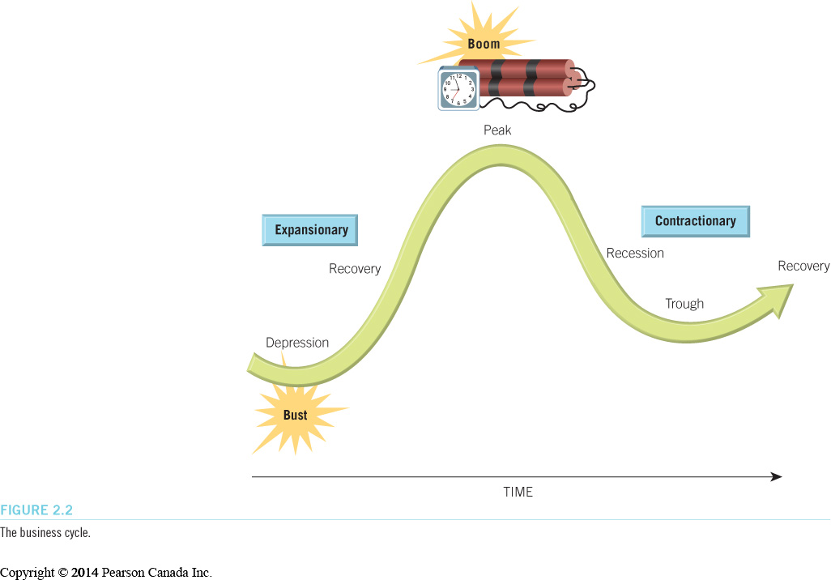
The Economic Environment
(LO 2-2)
Business Cycle
  The typical pattern of short-term ups and downs in an economy (peak, recession = economy shrinking for 2 consec. quarters, trough and recovery)
  Depression = severe and long-lasting recession
Copyright © 2014 Pearson Canada Inc.
2-<number>
Notes:
Learning Objective 2-2
Figure 2.2
Notes
Recession: a period during which aggregate output declines
Depression: severe and prolonged recession

Slide 9
The Economic Environment
(LO 2-2)
Aggregate Output
  Key measure of economic growth
  Total quantity of goods and services produced by an economic system during a given period
  An increase in aggregate output = growth
Standard of Living
  Total quantity and quality of goods and services that a country’s citizens can purchase with their currency
  When output/capita goes up + output grows more quickly than population, standard of living goes up
Copyright © 2014 Pearson Canada Inc.
2-<number>
Notes:
Learning Objective 2-2

Slide 10
The Economic Environment
(LO 2-2)
  Measuring Economic Growth
  Gross Domestic Product (GDP)
    value of all goods and services produced by a national economy within a given period through domestic factors of production
  Gross National Product (GNP)
    value of all goods and services produced by a national economy within a given period regardless of production location
Copyright © 2014 Pearson Canada Inc.
2-<number>
Notes:
Learning Objective 2-2

Slide 11
The Economic Environment
(LO 2-2)
  Measuring Economic Growth
  Real GDP
    GDP adjusted for changes in currency values and prices
    May indicate that the economy hasn’t grown
  Purchasing Power Parity https://www.investopedia.com/video/play/purchasing-power-parity-ppp/ https://www.youtube.com/watch?v=pbIhGTJe41k
    Exchange rates are set so that the prices of similar products in different countries are about the same
    Indicates what people can actually buy with their $$
Copyright © 2014 Pearson Canada Inc.
2-<number>
Notes:
Learning Objective 2-2

Slide 12
The Economic Environment
(LO 2-2)
Productivity
  Standard of living improves through increases in productivity
  Measure of economic growth that compares the output of an economic system with the resources that are needed to produce the output
  COUNTRIES WITH HIGHEST/LOWEST PRODUCTIVITY?
Copyright © 2014 Pearson Canada Inc.
2-<number>
Notes:
Learning Objective 2-2

Slide 13
The Economic Environment
(LO 2-2)
Balance of Trade
  Value of all exported products minus the value of imported products LATEST NUMBERS?
National Debt
  Amount of money that a government owes its creditors
  Increases by the amount of the budget deficit
  Can decrease when an economy has a budget surplus
  LATEST NUMBERS?
Copyright © 2014 Pearson Canada Inc.
2-<number>
Notes:
Learning Objective 2-2
Notes
Positive balance of trade: more exports = economic growth
Lower debt: more $ for private investment

Slide 14
The Economic Environment
(LO 2-2)
Economic Stability
  Condition in an economic system in which the amount of money available and the quantity of goods and services produced are growing at about the same rate
Deflation
Inflation
Unemployment
Threats to economic stability
Copyright © 2014 Pearson Canada Inc.
2-<number>
Notes:
Learning Objective 2-2
Activities
Questions for Analysis #2, 4

Slide 15
The Economic Environment
(LO 2-2)
Inflation
  Occurs when there is widespread price increases in an economic system
  More $$ injected into an economy than is its output – more $$ to spend but same amount of products to buy → competition drives prices up LATEST NUMBERS?
The Consumer Price Index (CPI)
  Tool used to measure inflation
Deflation
  A period of generally falling prices
  Bank of Canada will reduce interest rates to stimulate consumption
Copyright © 2014 Pearson Canada Inc.
2-<number>
Notes:
Learning Objective: 2-2
Table 2.1
Table 2.2
Figure 2.3

Slide 16
The Economic Environment
(LO 2-2)
Unemployment
  Level of joblessness among people actively seeking work in an economic system
Seasonal
Cyclical
Structural
Frictional
Types of Unemployment
Copyright © 2014 Pearson Canada Inc.
2-<number>
Notes:
Learning Objective 2-2
Notes
When unemployment is low, there is a labour shortage which raises wages and prices.
When wage rates are too high, workers are laid off, sales drop, more layoffs, etc.
If demand stays high and prices go up, inflation sets in.

Slide 17
The Economic Environment
(LO 2-2)
Managing the Canadian Economy
Fiscal Policies – BoC controls money supply, e.g. interest rates
Monetary Policies – collection and spending of revenues by govt, e.g. tax cuts
Stabilization policies – to reduce fluctuations in output and unemployment to stabilize prices
Copyright © 2014 Pearson Canada Inc.
2-<number>
Notes:
Learning Objective 2-2
Notes
High interest rates = tight monetary policy
Low interest rates = easy monetary policy
Stabilization Policies: fiscal and monetary policies used to stabilize prices and to smooth out fluctuations in output and unemployment
Fiscal policies: determine how the government collects and spends its revenues
Monetary policies: determine the size of a nation’s monetary supply

Slide 18
The Technological Environment
(LO 2-3)
Technology
  Includes all the ways a company creates value for its customers
    human knowledge, work methods, physical equipment, etc.
Research and Development (R&D)
  Provides new ideas for products services and processes
    basic
    applied
Copyright © 2014 Pearson Canada Inc.
2-<number>
Notes:
Learning Objective 2-3
Figure 2.5

Slide 19
The Technological Environment
(LO 2-3)
Product and Service Technologies
Process Technologies:
  used to improve a firm’s performance of its internal operations
Enterprise Resource Planning (ERP)
  a large-scale information system for organizing and managing a firm’s processes across product lines, departments and geographic locations
Copyright © 2014 Pearson Canada Inc.
2-<number>
Notes:
Learning Objective 2-3

Slide 20
The Technological Environment
(LO 2-3)
ERP Applications
Supply-chain management
  forecasting, purchasing, distribution
Accounting and Finance
  accounts payable and receivable, asset management
Manufacturing
  material requirements planning, scheduling
Copyright © 2014 Pearson Canada Inc.
2-<number>
Notes:
Learning Objective 2-3
Figure 2.6

Slide 21
The Political-Legal Environment
(LO 2-4)
Reflects the relationship between business and government (e.g., regulations)
  pro- or anti-business sentiment
    Canadaʼs federal government has put a halt to bank mergers WHAT’S CURRENT PROVINCIAL/FEDERAL BUSINESS SENTIMENT? https://tradingeconomics.com/canada/business-confidence
  political stability – Canadian firms will trade with countries that are stable, and foreign investors will come to Canada if our political environment is stable
  international relations – also affect biz activity EXAMPLE?
Copyright © 2014 Pearson Canada Inc.
2-<number>
Notes:
Learning Objective: 2-4
Notes
Political stability is necessary when doing business internationally or even between provinces. If relations between countries is poor, there is less likelihood of trade between these two countries

Slide 22
The Socio-Cultural Environment
(LO 2-5)
Customs, values, attitudes and demographic characteristics of the society in which an organization functions
Customer preferences and tastes
  vary across and within national boundaries
  vary within the same country
Ethical compliance and responsible business behaviour
Copyright © 2014 Pearson Canada Inc.
2-<number>
Notes:
Learning Objective 2-5
Notes
In today’s changing environment, it is often difficult to accurately track and understand a business’ competitive health. Stakeholders have a right to know how a company is performing in order to make competent and informed decisions.

Slide 23
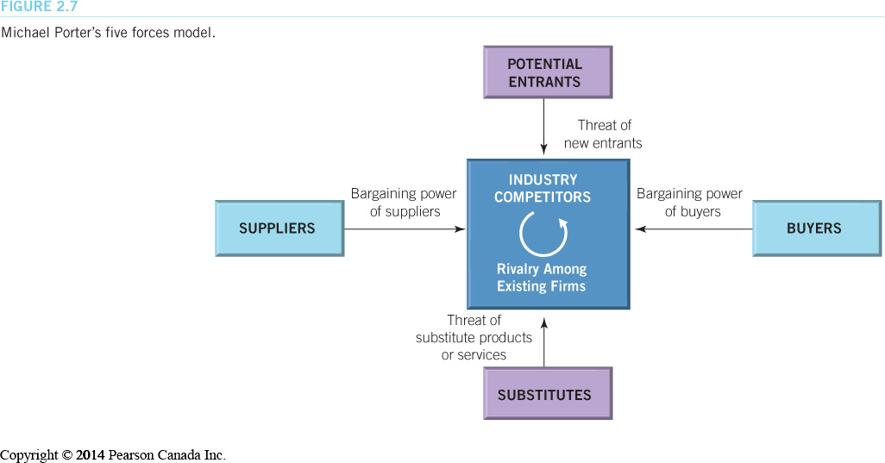
The Business Environment
(LO 2-6)
The Industry Environment
  Porter’s five forces model is used to analyze the competitive situation in an industry. GROUP WORK
Copyright © 2014 Pearson Canada Inc.
2-<number>
Notes:
Learning Objective 2-6
Figure 2.7

Slide 24
The Business Environment
(LO 2-6)
Emerging Challenges and Opportunities in the Business Environment
The most successful firms are getting leaner by focusing on their core competencies
  the skills and resources with which an organization competes best and creates the most value for owners
Copyright © 2014 Pearson Canada Inc.
2-<number>
Notes:
Learning Objective 2-6

Slide 25
The Business Environment
(LO 2-6)
Outsourcing
  paying suppliers and distributors to perform certain business processes
Viral Marketing
  using the Internet and word-of-mouth marketing to spread product information
Business Process Management
  moving away from department-oriented organizations toward process-oriented teams
Copyright © 2014 Pearson Canada Inc.
2-<number>
Notes:
Learning Objective 2-6

Slide 26
Redrawing Corporate Boundaries
(LO 2-7)
Acquisitions and Mergers
  A = one firm buys another
  M = 2 firms consolidate
  horizontal, vertical or conglomerate mergers (unrelated industries)
  friendly or hostile (1 firm buys enough shares of another to gain majority) takeovers
Divestitures and Spinoffs
  selling part of existing business or setting it up as a new corporation
Copyright © 2014 Pearson Canada Inc.
2-<number>
Notes:
Learning Objective 2-7

Slide 27
Redrawing Corporate Boundaries
(LO 2-7)
Divestitures and Spinoffs
  selling part of existing business (D) or setting it up as a new corporation (S)
  S –example – PepsiCo spun off Pizza Hut, KFC and Taco Bell into Yum! Brands Inc.
  D EXAMPLE?
Copyright © 2014 Pearson Canada Inc.
2-<number>
Notes:
Learning Objective 2-7

Slide 28
Redrawing Corporate Boundaries
(LO 2-7)
Employee-Owned Corporations
  employee stock ownership programs (ESOP)
Strategic Alliances
  two or more companies temporarily join forces
  often called a joint venture
Copyright © 2014 Pearson Canada Inc.
2-<number>
Notes:
Learning Objective: 2-7

Slide 29
Redrawing Corporate Boundaries
(LO 2-7)
Subsidiary and Parent Corporations
  subsidiary corporation owned by another corporation
  parent corporations own subsidiary corporations
Copyright © 2014 Pearson Canada Inc.
2-<number>
Notes:
Learning Objective: 2-7

